Slide 1
Are Vision-Language Transformers Learning Multimodal Representations? A Probing Perspective.
A Conference Paper at AAAI 2022
Presenter: Haoyu Song
Date: Feb 18, 2022

Slide 2
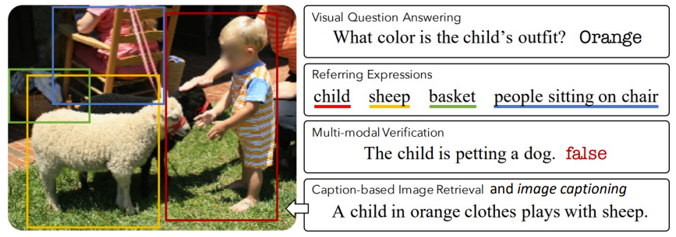
The Question
Vison-Language models jointly understand image and text modalities
What information is learned and forgotten in the multimodality representations?
How to analysis representations?
The toolkit: Probing
Image from: https://arxiv.org/pdf/1912.02315.pdf

Slide 3
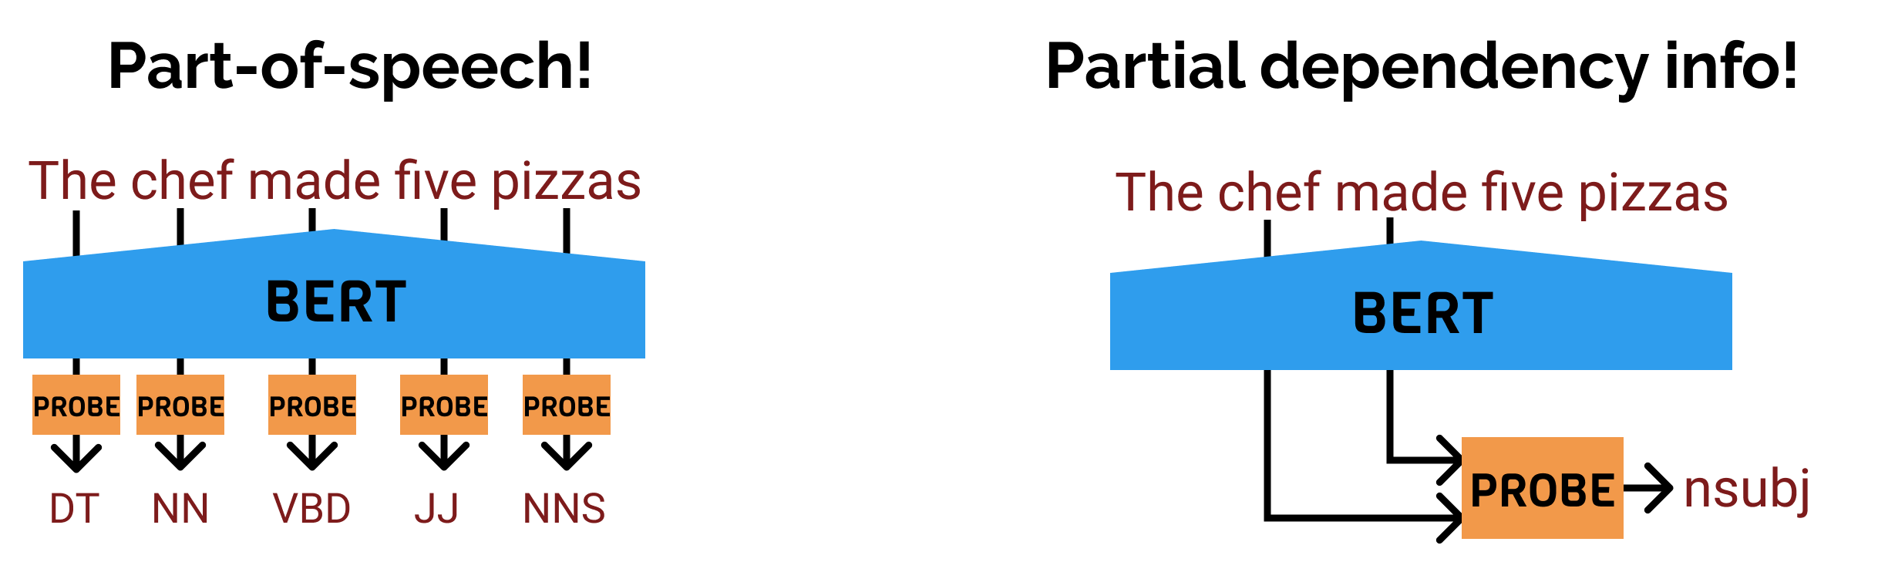
Preliminaries: Probing
Two steps in probing
Obtain the encoded representations of one system
Train another classifier over the representations on some other task
Probing turns supervised tasks into interpretation of representations
Also been referred to as diagnostic classifiers, auxiliary classifier
https://nlp.stanford.edu/~johnhew/interpreting-probes.html

Slide 4
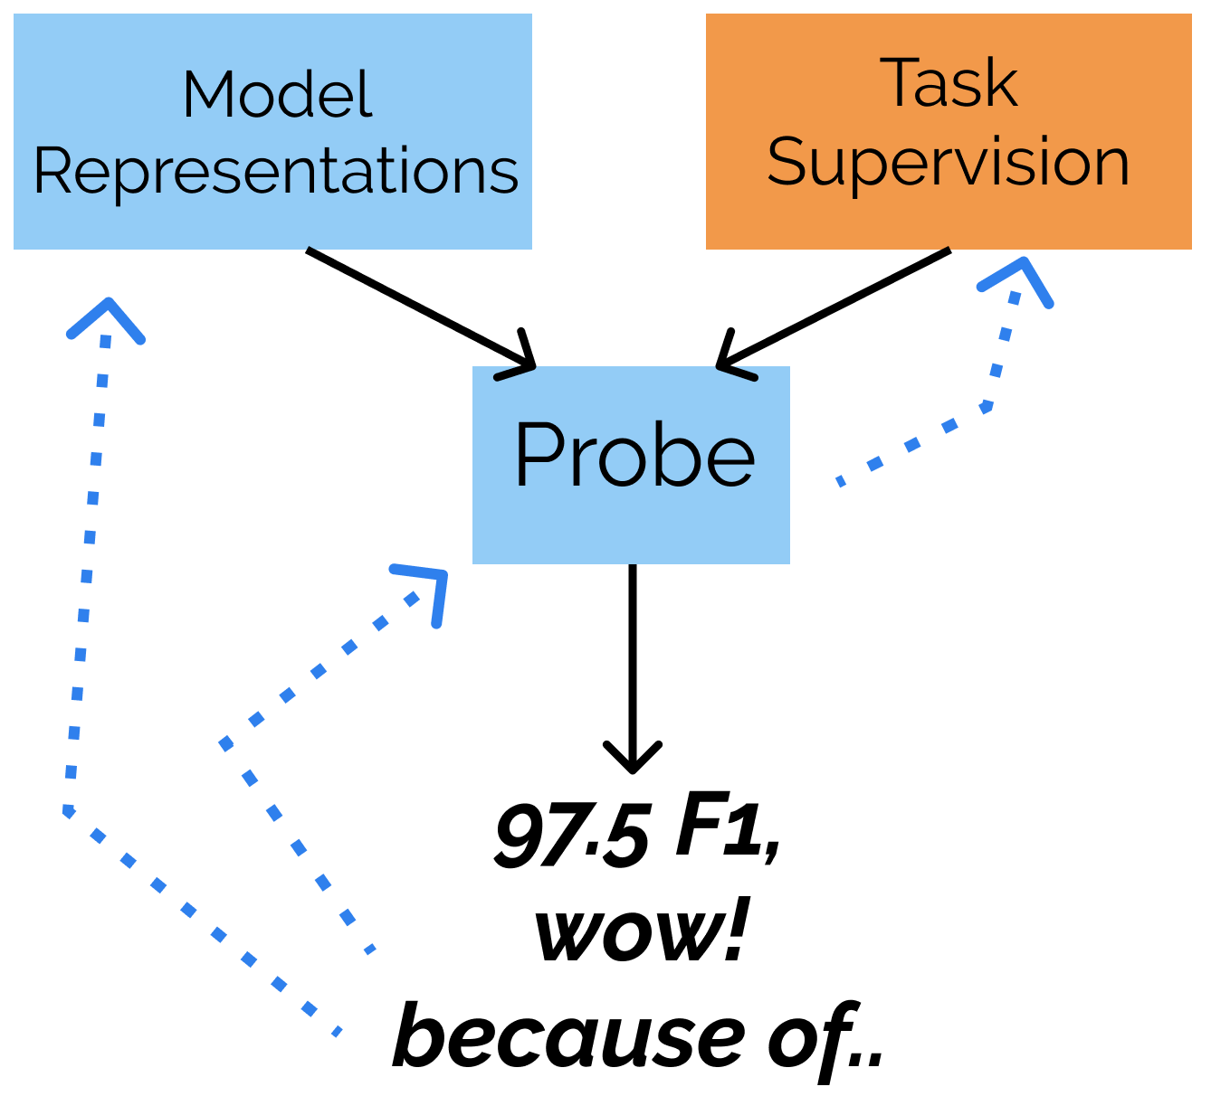
Preliminaries: Probing
Probing has a nice property of being testable
predictive of linguistic or visual property
accessible to a specific family of functions, such as linear
trained in a specific manner on a specific dataset
generalize to the held-out examples
better than a baseline representation
However, it is still unclear
did I interpret the representation?
or did my probe just learn the task itself?
“I think my representations are BETTER”
https://nlp.stanford.edu/~johnhew/interpreting-probes.html

Slide 5
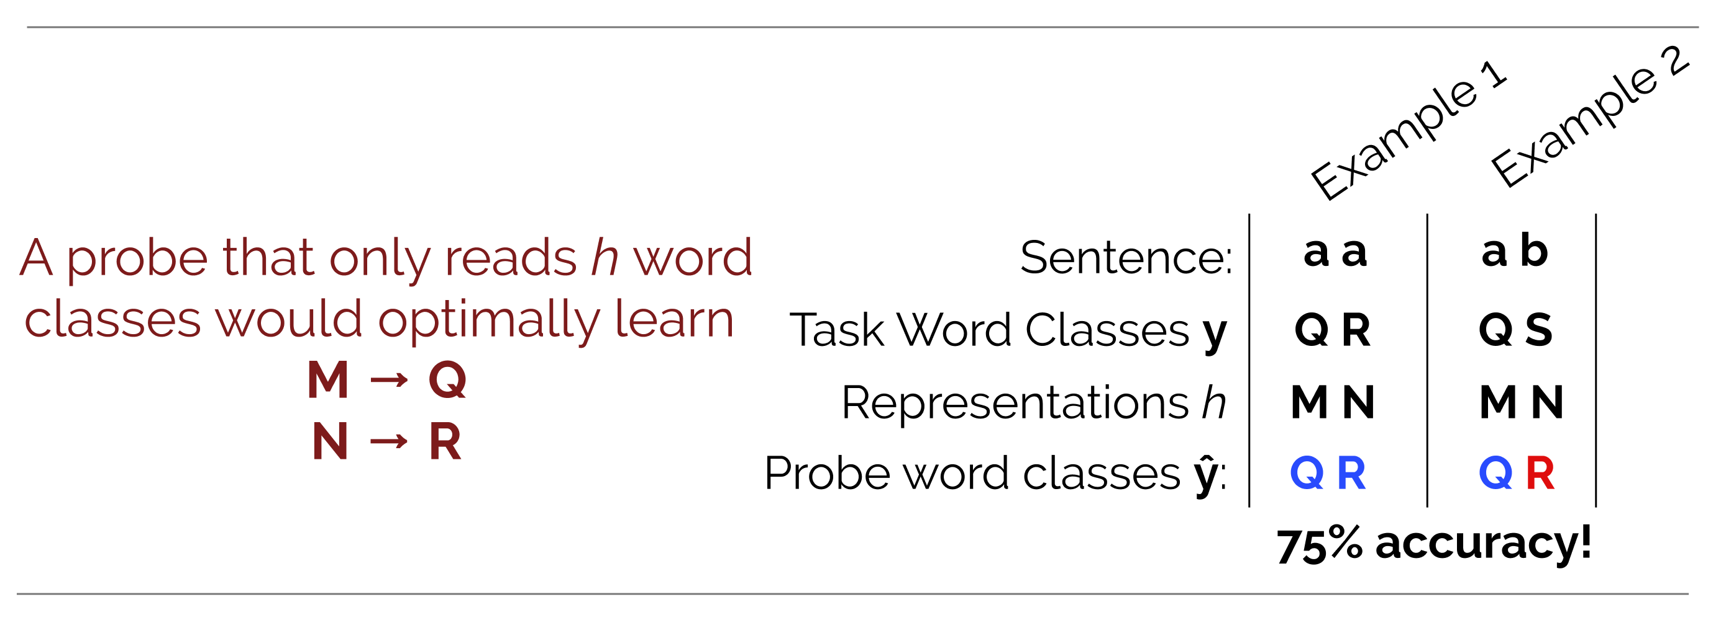
Preliminaries: The Probing Confounder Problem
Probing may leverage signals unrelated to the property
Leading to memorize outputs based on the unrelated signals
A toy example
Poor Representations
https://nlp.stanford.edu/~johnhew/interpreting-probes.html

Slide 6
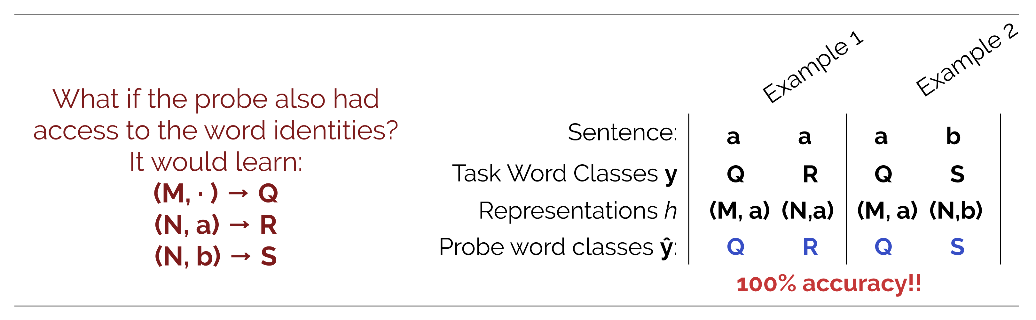
Preliminaries: The Probing Confounder Problem
Probing may leverage signals unrelated to the property
Leading to memorize outputs based on the unrelated signals
A toy example
In this example, probing leverages features unrelated to the desired properties
https://nlp.stanford.edu/~johnhew/interpreting-probes.html

Slide 7
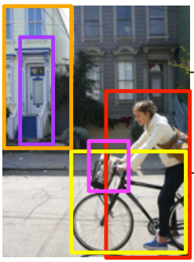

Background: Vision-Language Models
Three studied vision-language models in this paper
LXMERT: Learning Cross-Modality Encoder Representations from Transformers, EMNLP 2019
UNITER: UNiversal Image-TExt Representation Learning, ECCV 2020
ViLT: Vision-and-Language Transformer Without Convolution or Region Supervision, ICML 2021
A quick summary
More unified, Simpler
 | Region Feature | Linear Feature
Dual Stream | LXMERT | -
Single Stream | UNITER | ViLT
More unified, Simpler
vs
Examples of region feature and linear feature

Slide 8
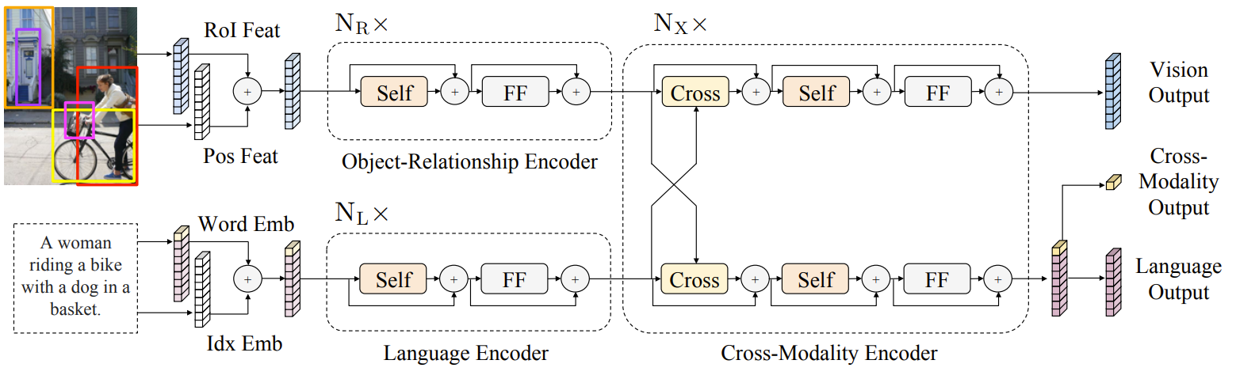
Background: Vision-Language Models
LXMERT
Dual Stream, Region Feature
Objects detected by Faster R-CNN
Experimented on VQA, GQA, NLVR

Slide 9
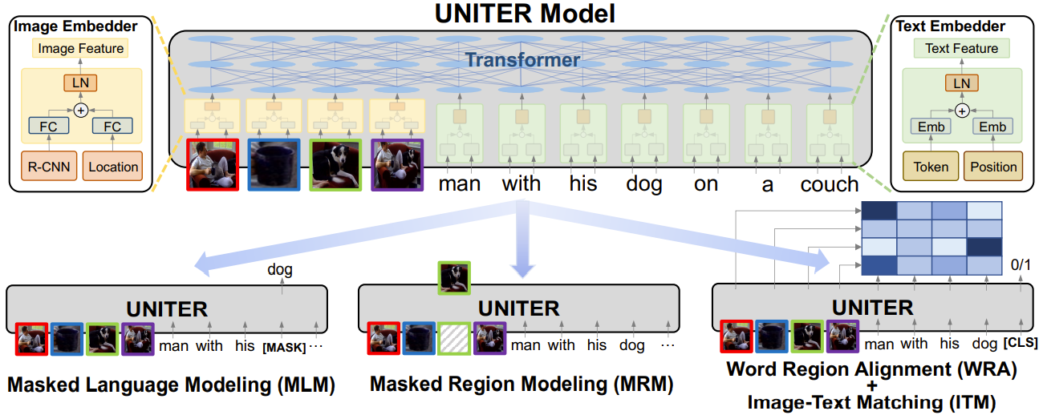
Background: Vision-Language Models
UNITER
Single Stream, Region Feature
Objects detected by Faster R-CNN
Experimented on VQA, Visual Entailment, NLVR, VCR, REC, Image-Text Retrieval

Slide 10
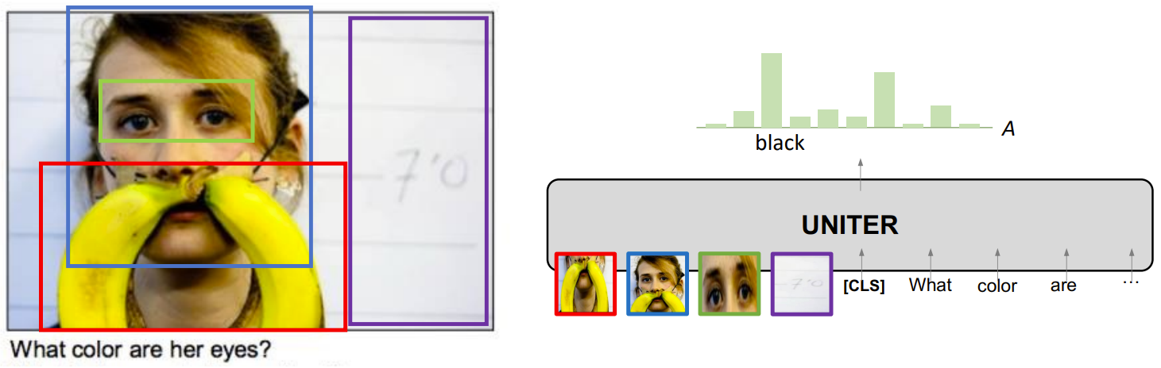
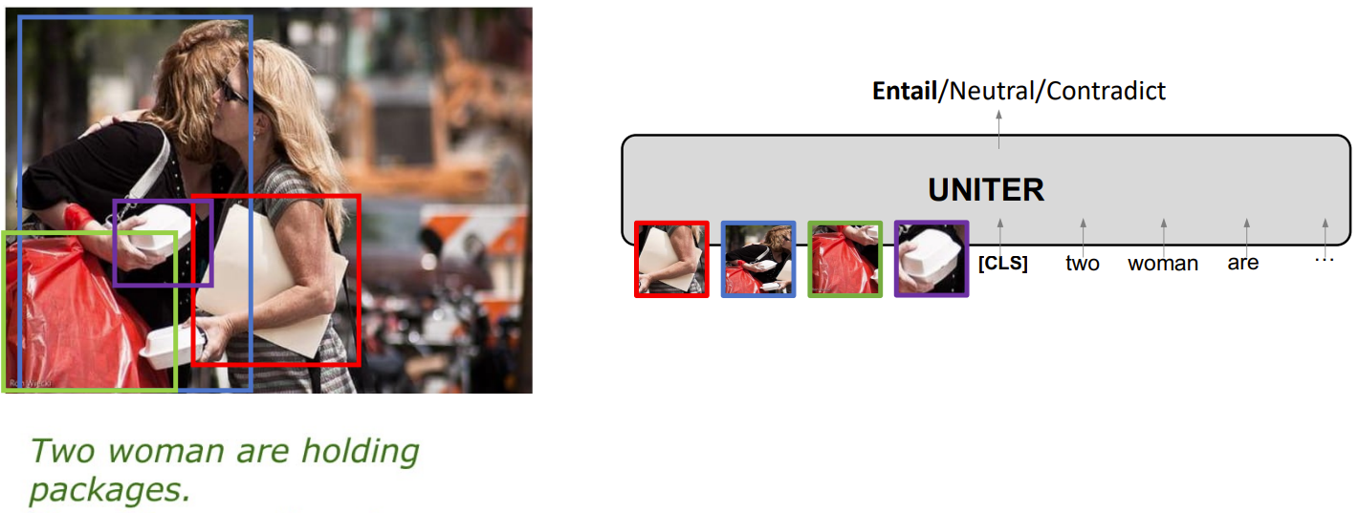
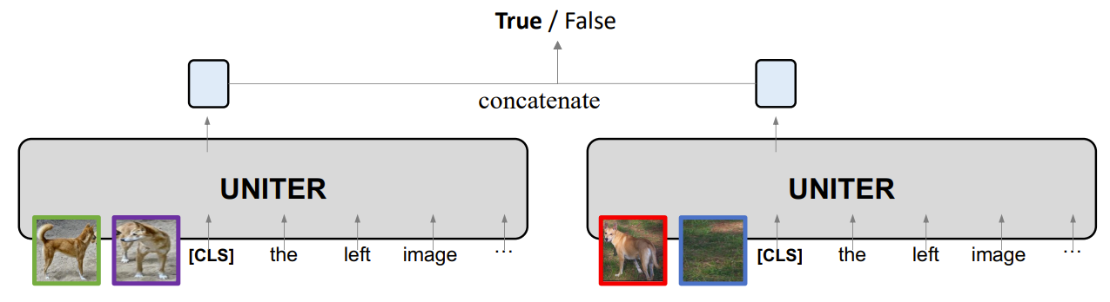
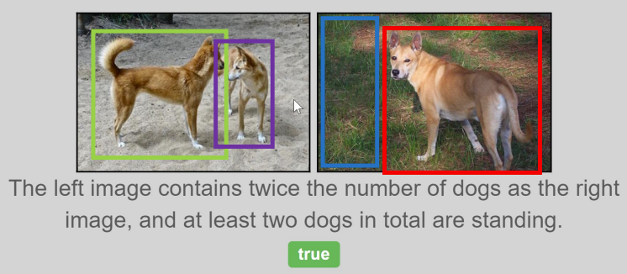
Background: Vision-Language Models
UNITER
VQA
Visual Entailment
NLVR

Slide 11
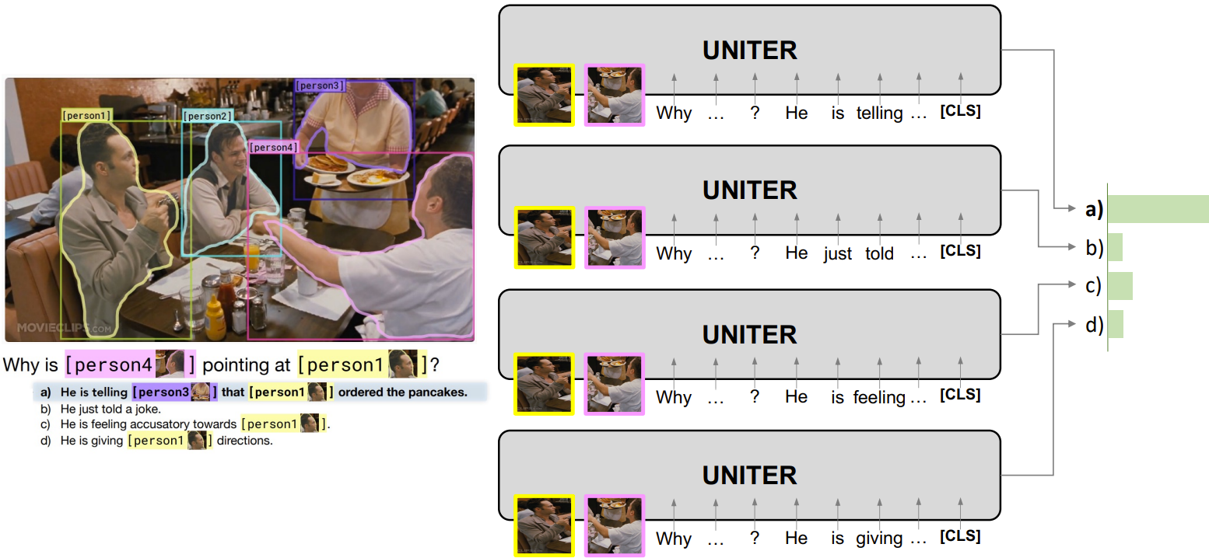
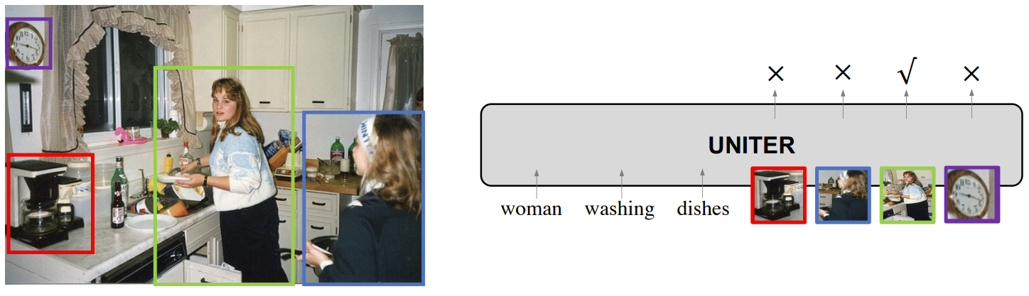
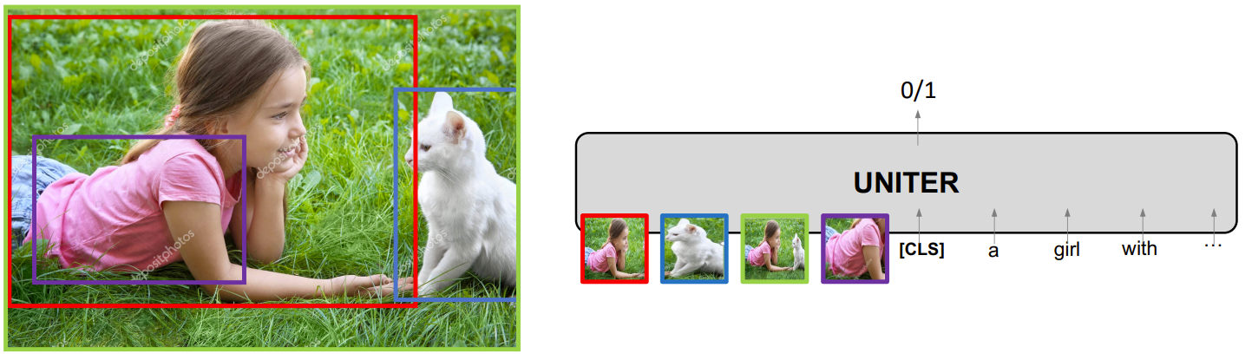
Background: Vision-Language Models
UNITER
Visual Commonsense Reasoning
Referring Expression Comprehension
Image-Text Retrieval

Slide 12
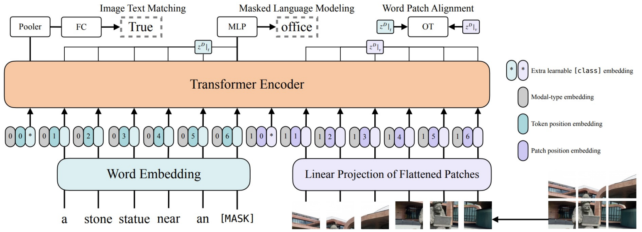
Background: Vision-Language Models
ViLT
Single Stream, Linear Feature
Without Convolution and Region Supervision
Experimented on VQA, GQA, NLVR

Slide 13
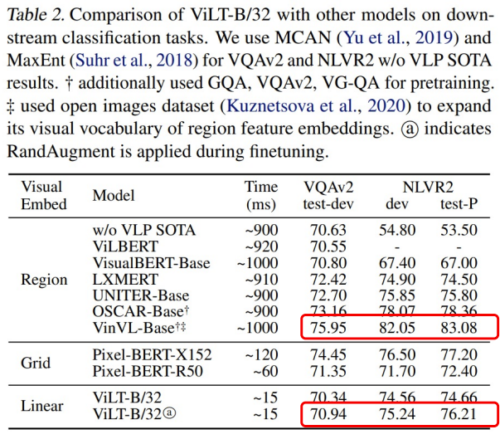

Background: Vision-Language Models
ViLT
Much faster than region features
But performance is not ideal

Slide 14
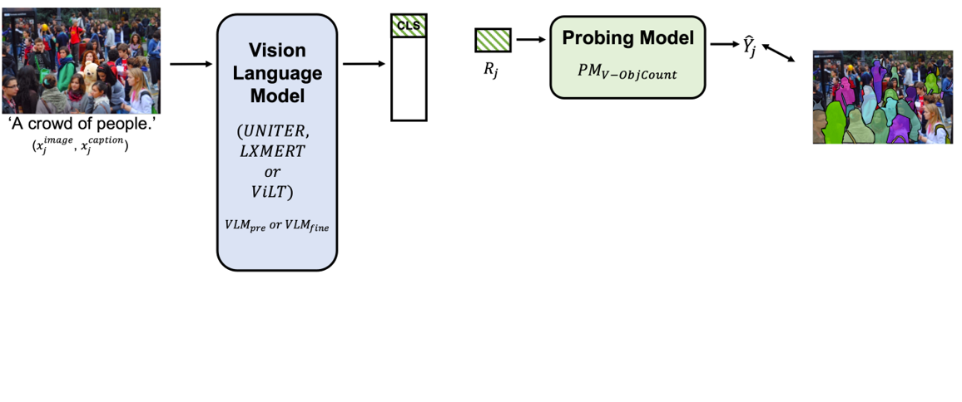
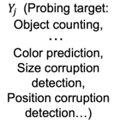
Analysis Methodology: Framework
Studying the Impact of Each Modality

Slide 15
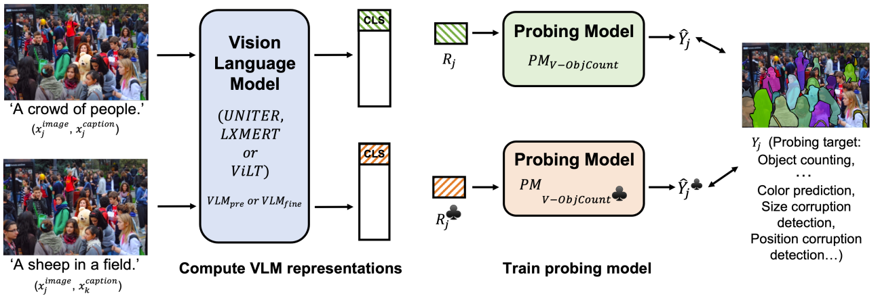
Analysis Methodology: Framework
Studying the Impact of Each Modality
♣ denotes an image-text mismatching setting for comparison

Slide 16
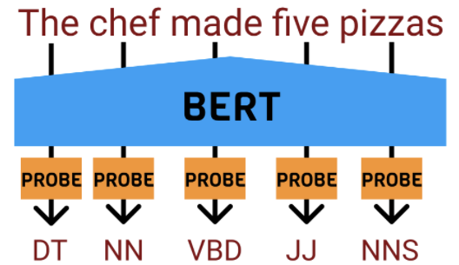
Analysis Methodology: Probing Tasks
Language Probing Tasks: L
PoS Tagging (L-Tagging) : Associate a word with its part of speech label (1 of 34 labels)
Bigram Shift (L-BShift) : Determine whether two words of bigram in a sentence been swapped
People relaxing at the park. √
People at relaxing the park. ×

Slide 17
Analysis Methodology: Probing Tasks
Vision Probing Tasks: V
Flower identification (V-Flower) : Classifying flower pictures into 102 categories
Object Counting (V-ObjCount) : Counting the number of all objects in a picture

Slide 18
Analysis Methodology: Probing Tasks
Multimodal Probing Tasks: M
Color Identification (M-Col) : Select from 8 common colors. 3,000 instances fromFlickr30k contain those colors, where the color word in caption is masked with [MASK].
Size Identification (M-Size) : Select among 56 concrete object categories that are present in the test set with opposite size adjectives (e.g., large vs small) to minimize linguistic cues.
Position Identification (M-Pos) : Select caption with position words and replace position with the opposite one. A linear binary determines if the caption has been modified.
Adversarial captions (M-Adv) : Select words related to visual-relevant grammatical categories (nouns, verbs, adjectives, numbers) to be replaced by the top predictions of a text-only BERT.

Slide 19
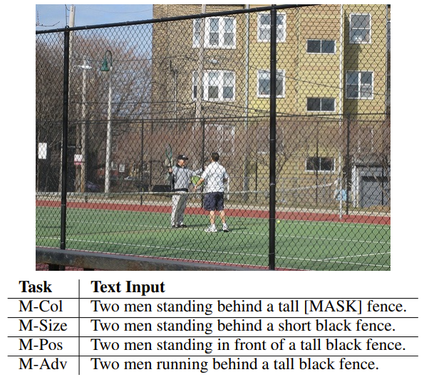
Analysis Methodology: Probing Tasks
Multimodal Probing Tasks: M
Color Identification (M-Col)
Size Identification (M-Size)
Position Identification (M-Pos)
Adversarial captions (M-Adv)

Slide 20
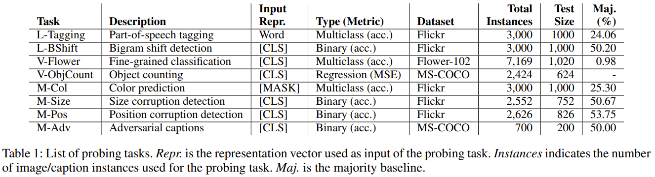
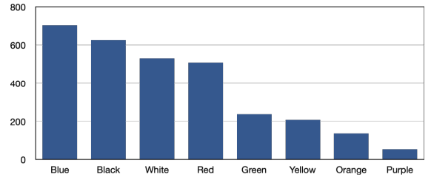
Analysis Methodology: Probing Tasks
Task Summary

Slide 21
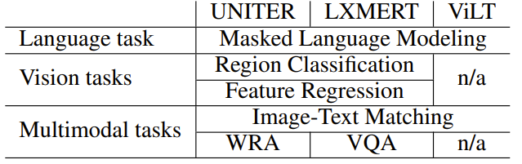
Experiment: Model Setup
Summary of the analyzed vision-language models
Architecture, Feature, and Pre-training Tasks
Probing on representations from original pre-trained VL models
Probing on representations from fine-tuned VL models (VQA and NLVR)
 | Region Feature | Linear Feature
Dual Stream | LXMERT | -
Single Stream | UNITER | ViLT

Slide 22
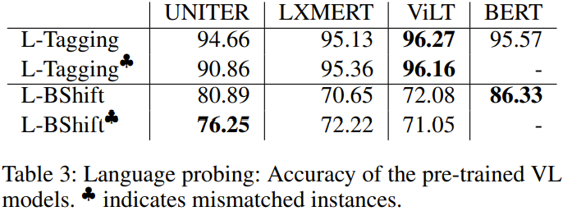
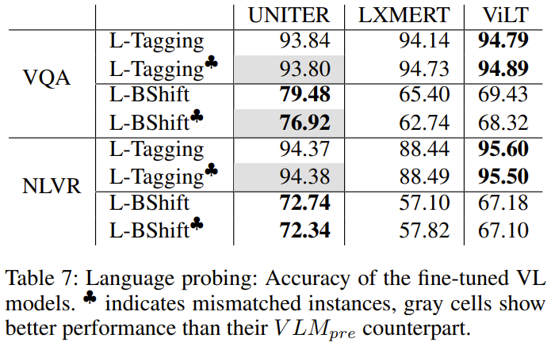
Experiment: Results
Language Probing Tasks: Pre-trained and Fine-tuned
 | Region Feature | Linear Feature
Dual Stream | LXMERT | -
Single Stream | UNITER | ViLT
Table 1. Architecture and Feature
Table 2. Pre-training Objectives

Slide 23
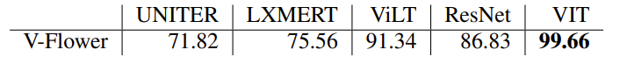
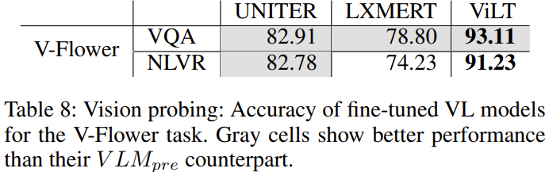
Experiment: Results of Pre-trained Models
Vision Probing Tasks: Pre-trained and Fine-tuned
 | Region Feature | Linear Feature
Dual Stream | LXMERT | -
Single Stream | UNITER | ViLT
Table 1. Architecture and Feature
Table 2. Pre-training Objectives
Table 4: Vision probing: Accuracy of pre-trained VL models for the fine-grained classification task.

Slide 24
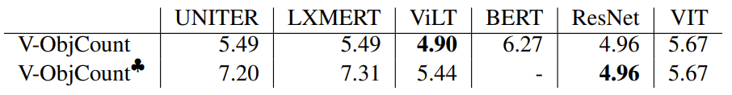
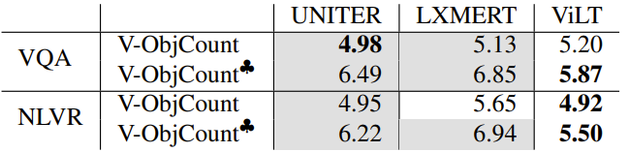
Experiment: Results of Pre-trained Models
Vision Probing Tasks: Pre-trained and Fine-tuned
 | Region Feature | Linear Feature
Dual Stream | LXMERT | -
Single Stream | UNITER | ViLT
Table 1. Architecture and Feature
Table 2. Pre-training Objectives
Table 5: Vision probing: Square Root of the Mean Square Error (RMSE) for pre-trained VL models on the V-ObjCount task (lower is better).
Table 9: Vision probing: RMSE for fine-tuned VL models on the V-ObjCount task.

Slide 25
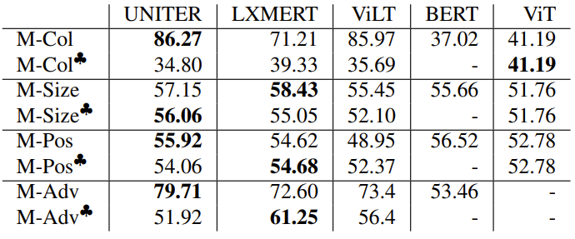
Experiment: Results of Pre-trained Models
Multimodal Probing Tasks : Pre-trained
 | Region Feature | Linear Feature
Dual Stream | LXMERT | -
Single Stream | UNITER | ViLT
Table 1. Architecture and Feature
Table 2. Pre-training Objectives
Table 6: Multimodal probing: Accuracy of pre-trained VL models. ♣ indicates mismatched instances.

Slide 26
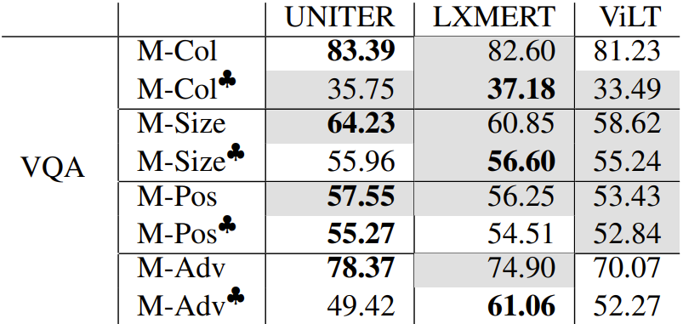
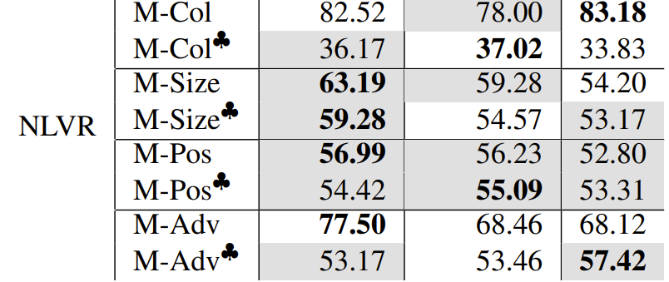
Experiment: Results of Pre-trained Models
Multimodal Probing Tasks : Fine-tuned
 | Region Feature | Linear Feature
Dual Stream | LXMERT | -
Single Stream | UNITER | ViLT
Table 1. Architecture and Feature
Table 2. Pre-training Objectives
Table 10: Multimodal probing: Accuracy of fine-tuned VL models. ♣ indicates mismatched instances, gray cells show better performance than their pre-trained counterpart.

Slide 27
Experiment: Discussion
For Datasets
Caption datasets have less varied syntactic structures than the text-only corpus
The caption datasets can help models learn fine-grained concepts better
For VL Models
Good vision probing does not guarantee better VL probing performance, e.g., ViLT & UNITER
The absence of object detection can limit the semantic understanding of object, e.g., ViLT in M-Adv
Linguistic cues is helpful for VL models’ performance on certain tasks, e.g., M-Pos and M-Size
Fine-tuning does not necessarily lead to better cross modal probing performance

Slide 28
Conclusion
Probing turns supervised tasks into interpretation of representations
The analyzed VL models learn less syntactic information than language-only model
VL models recognize colors well but have trouble understanding abstract concepts, such as position and size
For concepts not well learned the VL models show an over-reliance on linguistic clues

Slide 29
Thank You!
Any Questions?

